Slide 1
CS 295A/395D: Artificial Intelligence
LTL Applications
Prof. Emma Tosch
18 April 2022

Slide 2
Logistics
Reminders:
Worksheet due Friday in class
Remember: option to peer grade; must be in class to swap
Programming assignment out
When running into issues, please post questions on Teams!

Slide 3
Agenda
LTL
Review syntax and semantics
Example modeling problem
Model Checking
Applications of LTL

Slide 4
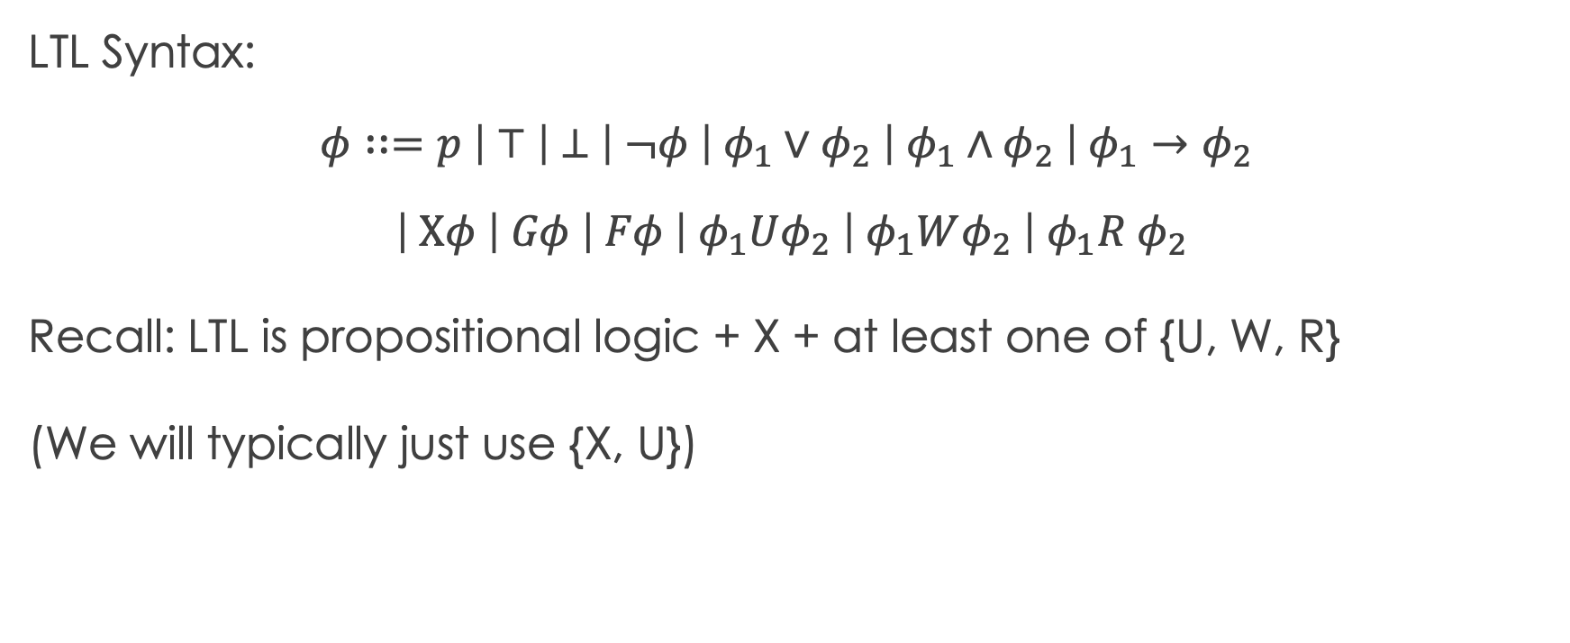
Recall: LTL Syntax
LTL Syntax:
$$φ∷=p \left| ⊤ \left| ⊥ \right| ¬φ \right| φ_{1}∨φ_{2} \left| φ_{1}∧φ_{2} \right| φ_{1}→φ_{2}$$
$$\left| Xφ \right| Gφ \left| Fφ \right| φ_{1}Uφ_{2} \left| φ_{1}Wφ_{2} \right| φ_{1}R φ_{2}$$
Recall: LTL is propositional logic + X + at least one of {U, W, R}
(We will typically just use {X, U})

Slide 5
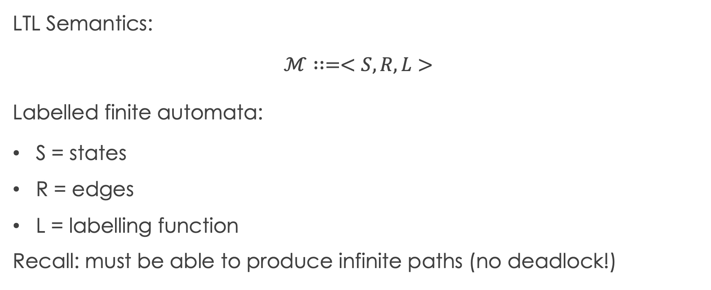
Recall: LTL Semantics
LTL Semantics:
$$ℳ∷=<S, R, L>$$
Labelled finite automata:
S = states
R = edges
L = labelling function
Recall: must be able to produce infinite paths (no deadlock!)

Slide 6
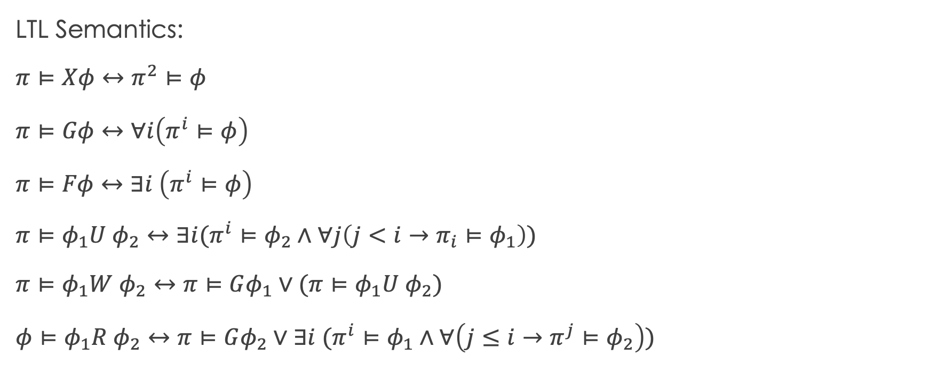
Recall: LTL Semantics
LTL Semantics:
$$π⊨Xφ↔π^{2}⊨φ$$
$$π⊨Gφ↔∀i\left(π^{i}⊨φ\right)$$
$$π⊨Fφ↔∃i \left(π^{i}⊨φ\right)$$
$$π⊨φ_{1}U φ_{2}↔∃i(π^{i}⊨φ_{2}∧∀j\left(j<i→π_{i}⊨φ_{1}\right))$$
$$π⊨φ_{1}W φ_{2}↔π⊨Gφ_{1}∨{(π⊨φ}_{1}U φ_{2})$$
$$φ⊨φ_{1}R φ_{2}↔π⊨Gφ_{2}∨∃i (π^{i}⊨φ_{1}∧∀\left(j≤i→π^{j}⊨φ_{2}\right))$$

Slide 7

LTL Exercises
Scenario: Hit by enemy before transport
Example:
p = Yar alive
q = Yar on our ship
r = transporter ready
State: Yar dead, not on ship
p, q, r

Slide 8
LTL Exercises
Scenario: Hit by enemy before transport
Example:
p = Yar alive
q = Yar on our ship
r = transporter ready
State: Yar dead, not on ship
p, q, r
r

Slide 9
LTL Exercises
Scenario: Hit by enemy before transport
Example:
p = Yar alive
q = Yar on our ship
r = transporter ready
State: Yar dead, not on ship
p, q, r
Transporter could be up or down (hit or not hit)
r

Slide 10
LTL Exercises
Scenario: Hit by enemy before transport
Example:
p = Yar alive
q = Yar on our ship
r = transporter ready
State: Yar dead, not on ship
p, q, r
Transporter could be up or down (hit or not hit)
Transporter can cycle
r
It takes time to charge

Slide 11
LTL Exercises
Scenario: Hit by enemy before transport
Example:
p = Yar alive
q = Yar on our ship
r = transporter ready
State: Yar dead, not on ship
p, q, r
Transporter could be up or down (hit or not hit)
Transporter can cycle
r
It takes time to charge

Slide 12
LTL Exercises
Scenario: Hit by enemy before transport
Example:
p = Yar alive
q = Yar on our ship
r = transporter ready
State: Yar dead, not on ship
p, q, r
Transporter could be up or down (hit or not hit)
Death is permeant
r
Transporter can cycle
It takes time to charge

Slide 13
LTL Exercises
Scenario: Yar transports onto enemy ship
Example:
p = Yar alive
q = Yar on our ship
r = transporter ready
p, q, r
r

Slide 14
LTL Exercises
Scenario: Yar transports onto enemy ship
Example:
p = Yar alive
q = Yar on our ship
r = transporter ready
Transporter takes time to recharge
p, q, r
p
r

Slide 15
LTL Exercises
Scenario: Yar transports onto enemy ship
Example:
p = Yar alive
q = Yar on enemy ship
r = transporter ready
Transporter takes time to recharge
Yar could die in this time
p, q, r
p
r

Slide 16
LTL Exercises
Scenario: Yar transports onto enemy ship
p, r
Example:
p = Yar alive
q = Yar on our ship
r = transporter ready
Transporter becomes ready
p, q, r
p
r

Slide 17
LTL Exercises
Scenario: Yar transports onto enemy ship
p, r
Example:
p = Yar alive
q = Yar on our ship
r = transporter ready
Transporter becomes ready
Yar has health; fights some more
p, q, r
p
r

Slide 18
LTL Exercises
Scenario: Yar transports onto enemy ship
p, q
p, r
Example:
p = Yar alive
q = Yar on our ship
r = transporter ready
Yar transports back
p, q, r
p
r

Slide 19
LTL Exercises
Scenario: Yar transports onto enemy ship
p, q
p, r
Example:
p = Yar alive
q = Yar on our ship
r = transporter ready
Yar transports back
Again, transporter takes time to recharge
p, q, r
p
r

Slide 20
LTL Exercises
Scenario: Yar transports onto enemy ship
p, q
p, r
Example:
p = Yar alive
q = Yar on our ship
r = transporter ready
Yar transports back
Again, ship could be hit
(before or after the transporter finishes charging)
p, q, r
p
r

Slide 21
LTL Exercises
Scenario: Yar transports onto enemy ship
p, q
p, r
Example:
p = Yar alive
q = Yar on our ship
r = transporter ready
Otherwise, return to starting state
p, q, r
p
r

Slide 22
LTL Exercises
s4
s3
p, q
p, r
Example:
p = Yar alive
q = Yar on our ship
r = transporter ready
s1
p, q, r
p
s2
r
s6
What are some true and false statements in LTL, given a path?
s5

Slide 23
LTL Exercises
Things to note/discuss:
s4
s3
p, q
p, r
Do we ever get stuck?
Example:
p = Yar alive
q = Yar on our ship
r = transporter ready
8 possible states, but this diagram only shows 6. Why?
s1
p, q, r
p
s2
Why no edge from s2 to s1?
r
s6
Why no edge from s3 to s5?
s5

Slide 24
Observed data vs. mechanism
Why do we not assume that Yar can die on an enemy ship, even when the transporter is ready?
Mechanistic?
Maybe our system automatically transports her back
Observationally?
Maybe we never observe her dying when the transporter is ready
Idea; there could be an edge; we currently don’t know the difference between the system and our modeling choice

Slide 25
Model design informed by LTL usage
LTL for checking state sequences
Given a trace, do certain properties hold?
Does Yar survive the encounter?
Does Yar return to our ship?
LTL for specifying goals
What properties do we want to hold?
Can we select actions to comport with goals?

Slide 26
LTL Exercises
Some state transitions are associated with
actions we take
s4
s3
p, q
p, r
Example:
p = Yar alive
q = Yar on our ship
r = transporter ready
s1
p, q, r
p
s2
r
s6
s5
Remaining transitions associated with environment dynamics

Slide 27
LTL Exercises
Some state transitions are associated with
actions we take
s4
s3
p, q
p, r
Example:
p = Yar alive
q = Yar on our ship
r = transporter ready
s1
p, q, r
p
s2
r , ~r
s6
s5
Remaining transitions associated with environment dynamics

Slide 28
Model checking
Recall, a model satisfies a formula iff all paths satisfy the formula
Model checking approach:
Let a trace be a sequence of atoms and their values. A trace can be constructed from a path
Given a formula we want satisfied, construct an automaton such that if the automaton does not satisfy the formula, the automaton accepts the trace.
Walk through both the model and the automaton in tandem; if the automaton accepts a trace, then the model does not satisfy the formula.

Slide 29


Model checking software

Slide 30
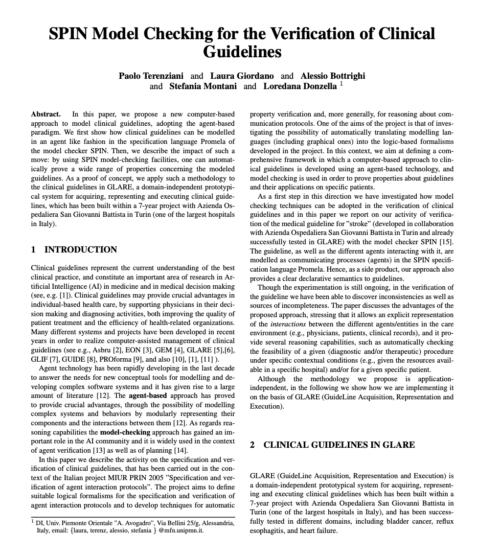
Application: Medicine
Verification of medical protocols, e.g., treatment guidelines
Models interaction between physicism and ontology consisting of:
Patient information
Treatment protocols
Current state

Slide 31
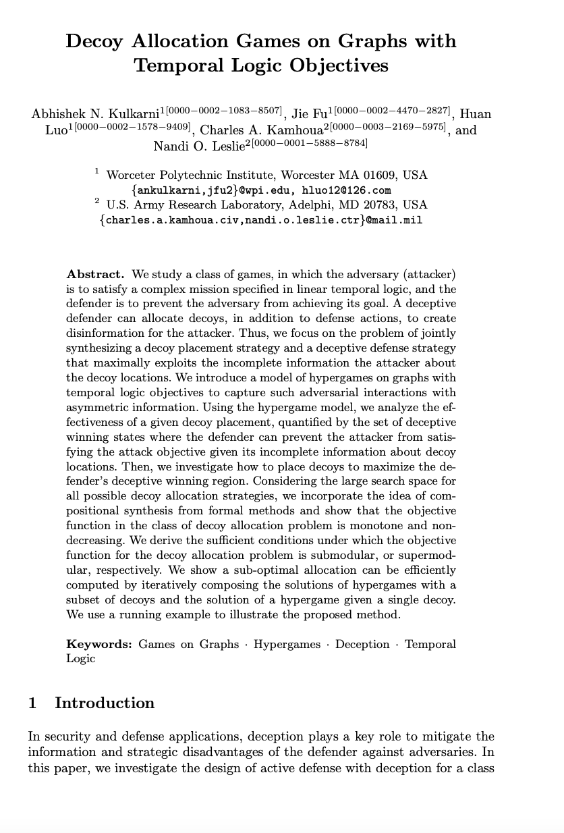
Application: Security
Verification of defense against a threat model over time
Models interaction between a defense strategy (allocating decoys in a networked environment) and adversarial behavior

Slide 32
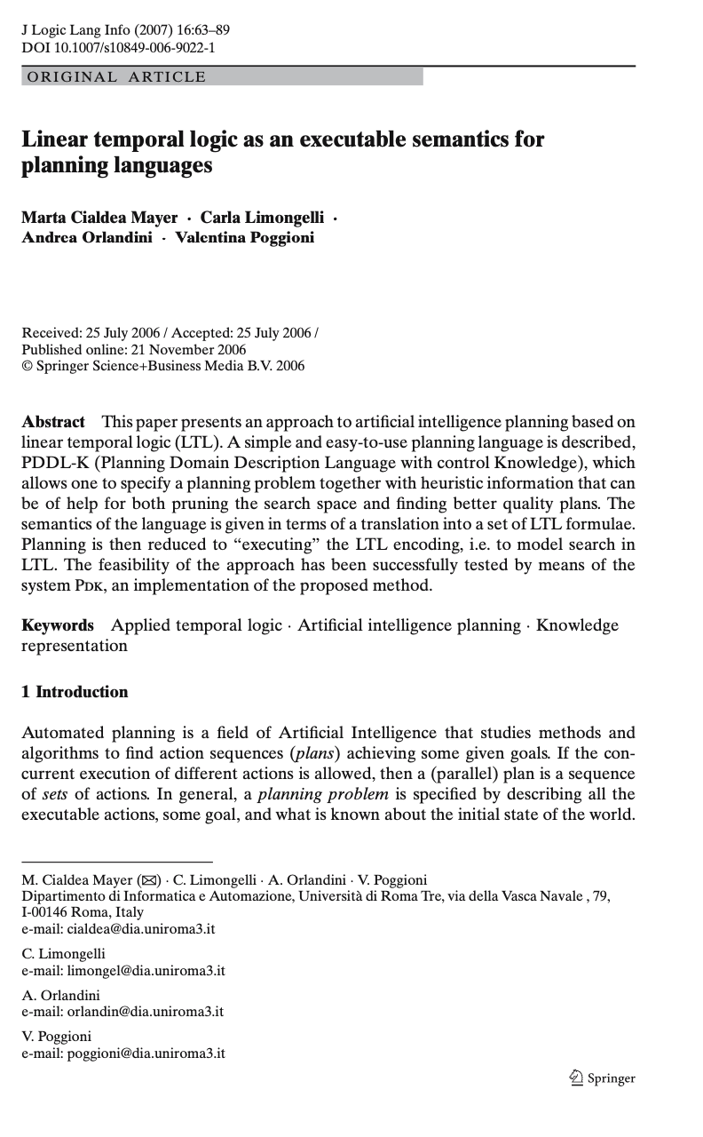
Application: AI Planning
Classical planning does not capture time
Use LTL to temporally extend actions
Use a high-level language (e.g., PDDL) to encode plans
Compile to LTL to be consistent with both action and environment dynamics

Slide 33
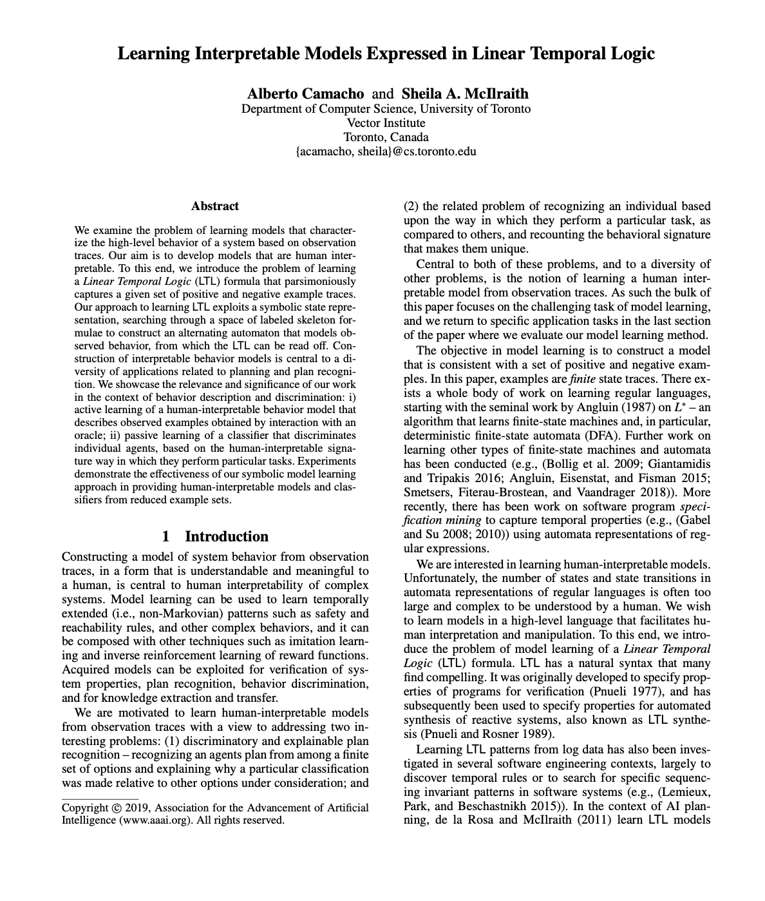
Application: AI interpretability
Idea: observe sequences of state
Learn LTL formulas to capture system invariants over time
Claim: Can be used to generate interpretable policies over complex software systems

Slide 34
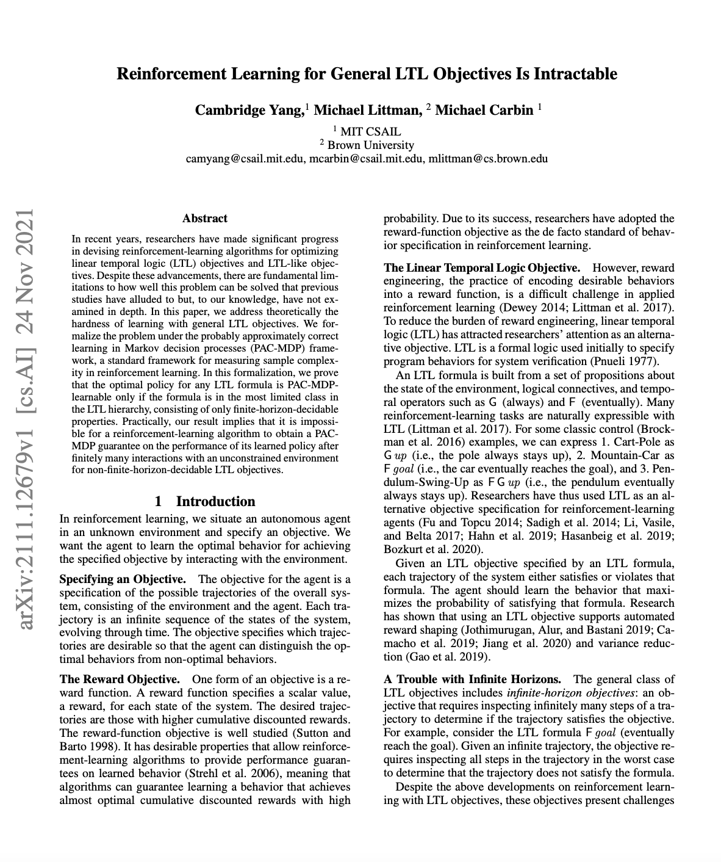
Intractability of LTL
Utility-driven objectives can be expressed in LTL
Problem: LTL formulae over paths
Exponential blow-up not just in state space (known issue), but also over paths

Slide 35
What other problems might we face?

